Slide 1

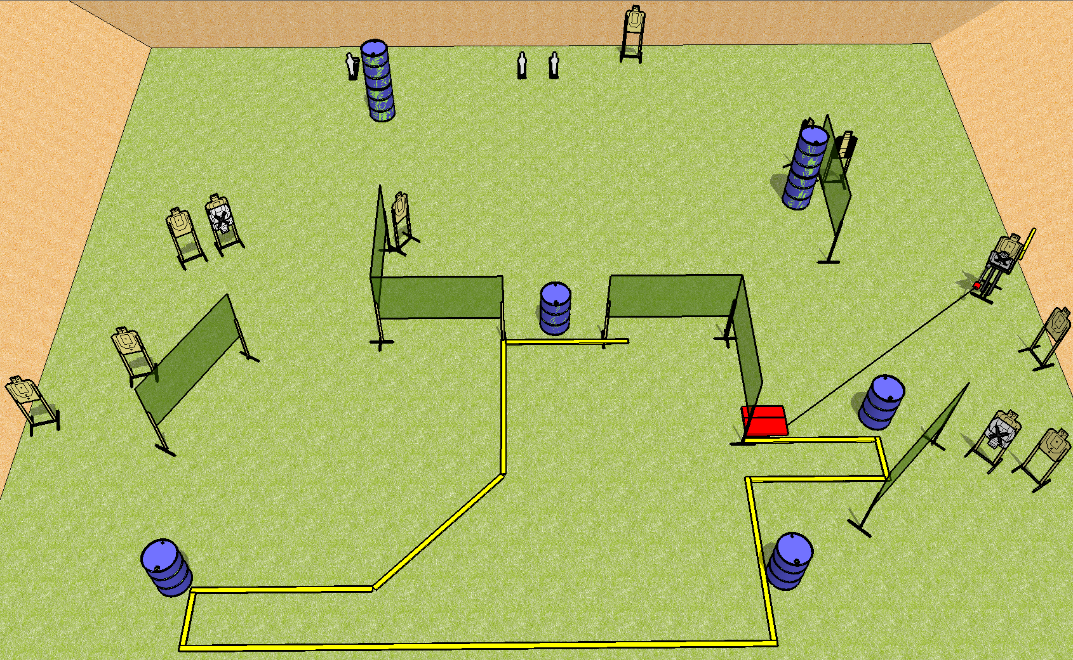
 | Dothan Practical Shooters – USPSA Match Dysfunction Junction Course Designer : Drew Coleman Bay: B2
Round Count 27 rounds 12 USPSA 3 mini poppers
Equipment List 12 wall feet Max trap + stomp pad 2 tux 13 (10 + 3NS)

Slide 2
Dysfunction Junction
Written Stage Briefing
Scoring: Comstock Rounds: 27
Targets: 12 USPSA, 3 steel
Start position: anywhere completely outside the shooting area, fingers touching ears. Firearm is on any barrel, unloaded and unpropped. All magazines to be used must start on any other barrel.
Stage Procedure: on the audible start signal, engage targets as they become available from within the shooting area. The max trap is activated by the stomp pad and remains visible at rest.

